Slide 1
Fluids and Electrolytes
Balance and Disturbance

Slide 2
Objectives
To Differentiate between osmosis, diffusion, filtration and active transport.
To describe the role of kidneys, lungs and endocrine glands in regulating the body’s fluid composition and volume.
To describe the cause, clinical manifestations and fluid volume and electrolytes imbalance management.
To Identify care plan of patients with fluid volume and electrolytes imbalance.

Slide 3
Homeostasis
State of equilibrium in body
Naturally maintained by adaptive responses
Body fluids and electrolytes are maintained within narrow limits

Slide 4
Composition of body fluids
60% of body weight in adult
45% to 55% in older adults
70% to 80% in infants
  Varies with gender, body mass, and age
Men, younger and thin people have more water than women, older and obese people

Slide 5
Fluid Compartments
Intracellular fluid (ICF): Located within cells (40% of body weight)
Extracellular fluid (ECF):found outside cell (20% of body weight )
  Intravascular: fluid within blood vessels (plasma)
  Interstitial: fluid that surrounds the cell (Lymph)
  Transcellular
  (cerebrospinal, pericardial and plural fluids and digestive secretions)
  Third space fluid shift: loss of ECF into space that does not contribute to equilibrium
  when too much fluid moves from the intravascular space into the interstitial or "third" space-the nonfunctional area between cells. This can cause potentially serious problems such as edema, reduced cardiac output, and hypotension.

Slide 6
Electrolytes
Active chemicals that carry positive (cations), negative (anions) electrical charges
  Major cations: sodium, potassium, calcium, magnesium, hydrogen ions
  Major anions: chloride, bicarbonate, phosphate, sulfate, ions

Slide 7
Regulation of fluids
Movement of fluid through capillary walls depends on
  Hydrostatic pressure: exerted on walls of blood vessels
  Osmotic pressure: exerted by protein in plasma
Direction of fluid movement depends on differences of hydrostatic, osmotic pressure

Slide 8
Transport process
Osmosis
Diffusion
Active transport
filtration

Slide 9
Osmosis:
Movement of water between two compartments by a membrane permeable to water but not to solute
Moves from low solute to high solute concentration
Requires no energy.
Diffusion:
Random movement of particles in all directions from an area of high concentration to low concentration.
Active transport:
Relies on availability of carrier substances, utilizes energy (ATP), to transport solutes in and out of cells.
Sodium-Potassium pump

Slide 10
Fluids gains and Losses
Daily average of Intake and output (I&O) of water are approximately equal
Intake: fluids, food, oxidation
Output:
Kidneys: urine: 1-2 Liter/day
Out put= 1 ml of urine per kilogram of body weight per hour (1 ml/kg/h)
Skin: Sensible loss (0-1000 ml) and insensible (500 ml)
Lungs: insensible loss (300 ml)
Gastrointestinal tract: 100-200 ml/day

Slide 11
Homeostatic Mechanism
Aim: to keep the composition and volume of body fluid within narrow limits of normal.
Methods:
1- Kidney: Regulation of ECF volume and Electrolytes levels by selective retention and excretion. Regulation of PH of the ECF by retention of hydrogen. Excretion of metabolic waste.
2- Heart and Blood vessel: Pumping
3- Lung functions: Exhalation and acid base balance
4-Pitutary function: ADH
5- Adrenal function: Aldosterone, Cortisol

Slide 12
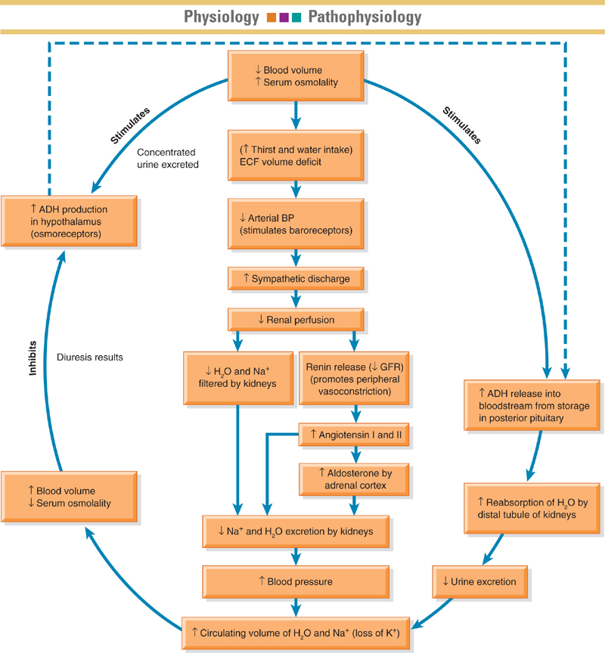

Slide 13
Gerontologic consideration
Reduced homeostatic mechanisms: cardiac, renal, respiratory function
Decreased body fluid percentage
Medication use
Presence of concomitant conditions

Slide 14
Fluid volume disturbances
1-ECF volume deficit (hypovolemia)
Loss of extracellular fluid exceeds intake ratio of water. Electrolytes lost in same proportion as they exist in normal body fluids
Dehydration: loss of water along with increased serum sodium level.
Causes: vomiting, diarrhea, fistula drainage, hemorrhage, inadequate intake , or third space shift: plasma-to-interstitial fluid shift

Slide 15
Hypovolemia (FVD)
Signs and symptoms
decreased skin turgor, prolonged capillary filling time, oliguria, concentrated urine, postural hypotension, rapid weak pulse, increased temperature, cool clammy skin due to vasoconstriction, , thirst, nausea, muscle weakness, cramps.
Laboratory data: elevated BUN in relation to serum, increased urine specific gravity and osmolality, increased creatinine, increased hematocrit.
  Serum electrolyte changes may occur.

Slide 16
Treatment for Fluid Volume Deficit (FVD)
  Give Oral fluid
  Insert intravenous fluid: (lactated ringer solution, 0,9% , 0.45% sodium chloride)
  Manage the effects and prevent further complications by monitoring intake & output, weight, assessing lab values, and observing vital signs, central Venus pressure, level of consciousness, skin color and integrity

Slide 17
Fluid volume deficit- nursing management
Monitor and measure I&O every 8 hours to hourly
Monitor body weight: loss of 0.5 kg represent fluid loss of 500 ml
Monitor vital signs (Vs
Monitor for symptoms: skin turgor, mucosa, urine specific gravity, mental status
Measures to minimize fluid loss
Oral care
Administration of oral fluids
Administration of parenteral fluids

Slide 18
Hypervolemia : fluid volume excess (FVE)
Expansion of the ECF caused by abnormal retention of water and sodium in approximately same proportion in which they normally exist in the ECF
Causes:
fluid overload, heart failure, renal failure, liver cirrhosis, excessive salt intake, excessive administration of sodium-containing fluid in patients with impaired regulatory mechanism

Slide 19
Hypervolemia
Causes: fluid overload or diminished homeostatic mechanisms
Risk factors: heart failure, renal failure, cirrhosis of liver
Contributing factors: excessive dietary sodium or sodium-containing IV solutions
Manifestations: edema, distended neck veins, abnormal lung sounds (crackles), tachycardia, increased BP, pulse pressure and CVP, increased weight, increased UO, shortness of breath and wheezing

Slide 20
Hypervolemia
Medical management:
Treat causes.
Restriction of fluids and sodium,
Administration of diuretics
Dialysis

Slide 21
Hypervolemia: Nursing management
Monitor I&O and daily weights
Assess lung sounds, edema, other symptoms
Monitor responses to medications- diuretics
Promote adherence to fluid restrictions, patient teaching related to sodium and fluid restrictions
Monitor, avoid sources of excessive sodium, including medications
Promote rest
Semi-Fowler’s position for orthopnea
Skin care, positioning/turning

Slide 22
Hyponatremia: Sodium deficit
(Serum sodium less than 135 mEq/L)
Causes: adrenal insufficiency, water intoxication, SIADH(syndrome of inappropriate antidiuretic hormone section) or losses by vomiting, diarrhea, sweating, diuretics
Manifestations: poor skin turgor, dry mucosa, headache, decreased salivation, decreased BP, nausea, abdominal cramping, neurologic changes: status epilepticus, coma
Acute hyponatremia : cerebral edema, brain herniation
Medical management: water restriction, sodium replacement: oral or parenteral:lactated ringer, 0.9%sodium chloride

Slide 23
Hyponatremia: nursing management
Identify and monitor patients at risk
Monitor daily fluids I&O and body weight
Monitor dietary sodium and effects of medications (diuretics, lithium)
Assess central nervous system changes: confusion, seziures

Slide 24
Sodium excess : Hypernatremia
Serum sodium greater than 145mEq/L
Causes: excess water loss, excess sodium administration, diabetes insipidus, heat stroke, hypertonic IV solutions,watery diarrhea, burns, hyperventilation.
Manifestations: thirst; elevated temperature; dry, swollen tongue; sticky mucosa; neurologic symptoms; restlessness; weakness
Medical management: hypotonic electrolyte solution (0. or D5W

Slide 25
Hypernatremia: nursing management
Monitor and prevention for patients at risk for hypernatremia
Assess for abnormal loss of water or low water intake and large gain of sodium
Assess medication history (OTC medications)
Assess elevated temperature, thirst and relation to other signs and symptoms.
Assess changes in behaviour : restlessness, disorientation, lethargy

Slide 26
Potassium deficit: Hypokalemia
Level of potassium below 3.5 mEq/L.
Also it may occur with normal potassium levels with alkalosis due to shift of serum potassium into cells.
Causes: GI losses, medications, alterations of acid-base balance, hyperaldosterism, poor dietary intake
Manifestations: fatigue, anorexia, nausea, vomiting, dysrhythmias, muscle weakness and cramps, paresthesias, glucose intolerance, decreased muscle strength, DTRs (deep tendon reflexes) Tonic contraction of the muscles in response to a stretching force, due to stimulation of muscle proprioceptors.
Severe hypokalemia causes respiratory and cardiac arrest

Slide 27
Hypokalemia
Medical management: increased dietary potassium, potassium replacement, IV for severe deficit
Nursing management:
Monitor for its early presence in patients at risk.
Assess serum potassium in: fatigue, anorexia, muscle weakness, decreased muscle mobility, paresthesia, dysrhythmias .
Monitor ECG
Monitor for digital toxicity in patients with hypokalemia
Encourage potassium diet.
Monitor IV potassium administration (infusion pump, ECG, BUN, urine Output )

Slide 28
Hyperkalemia
Serum potassium greater than 5.0 mEq/L
Causes: usually treatment related, impaired renal function, hypoaldosteronism, tissue trauma, acidosis
Manifestations: cardiac changes and dysrhythmias, muscle weakness with potential respiratory impairment, paresthesias, anxiety, GI manifestations
Medical management: monitor ECG (Peacked T wave) and potassium level, limitation of dietary potassium, cation-exchange resin (Kayexalate), IV sodium bicarbonate , IV calcium gluconate, regular insulin and hypertonic dextrose IV, β-2 agonists, dialysis

Slide 29
Nursing management
Monitor patients at risk
Prevention
Monitor S & S of hyperkalemia
Monitor I& O
Observe for muscle weakness, dysrhythmia, paresthesia, Potassium level, BUN, Arterial blood gas,
Observe apical pulse
monitor medication affects, dietary potassium restriction/dietary teaching for patients at risk.
Hemolysis of blood specimen or drawing of blood above IV site may result in false laboratory result
Potassium-sparing diuretics may cause elevation of potassium
  (Should not be used in patients with renal dysfunction)

Slide 30
Hypocalcemia
Serum level less than 8.5 mg/dL, must be considered in conjunction with serum albumin level
Causes: hypoparathyroidism, malabsorption, pancreatitis, alkalosis, massive transfusion of citrated blood, renal failure, medications, other
Manifestations: tetany, circumoral numbness, paresthesias, hyperactive DTRs, Trousseau’s sign, Chovstek's sign, seizures, respiratory symptoms of dyspnea and laryngospasm, abnormal clotting, anxiety

Slide 31
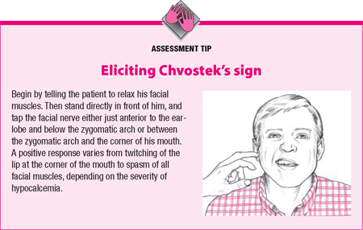

Slide 32
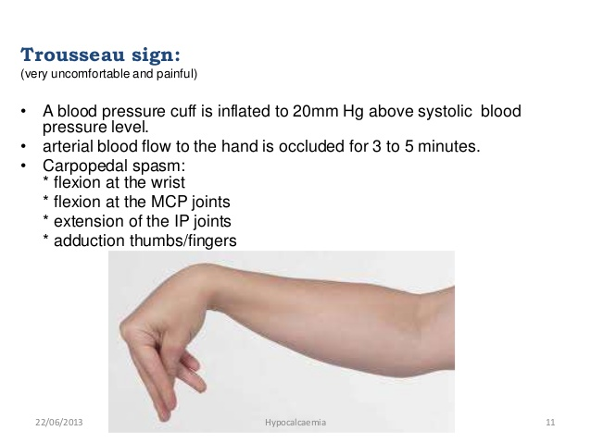

Slide 33
Medical management: IV of calcium gluconate, calcium and vitamin D supplements; diet
Nursing management: assessment, severe hypocalcemia is life-threatening, weight-bearing exercises to decrease bone calcium loss, patient teaching related to diet and medications, and nursing care related to IV calcium administration

Slide 34
Hypercalcemia
Serum level above 10.5 mg/dL
Causes: malignancy and hyperparathyroidism, bone minerals loss related to immobilisation
Manifestations: muscle weakness, incoordination, anorexia, constipation, nausea and vomiting, abdominal and bone pain, polyuria, thirst, ECG changes, dysrhythmias
Medical management: treat underlying cause, fluids, furosemide, phosphates, calcitonin, biphosphonates

Slide 35
Hypercalcemia: nursing management
Assessment of high risk patients, (hypercalcemic crisis has high mortality)
Encourage ambulation
fluids of 3 to 4 L/d, provide fluids containing sodium unless contraindicated, fiber for constipation, ensure safety

Slide 36
Hypomagnesemia
Serum level less than 1.3 mg/dL (associated with hypokalemia and hypocalcemia). Mesured in combination with Albumin
Causes: alcoholism, GI losses, enteral or parenteral feeding deficient in magnesium, medications (aminoglycoside, cyclosporin), rapid administration of citrated blood
Contributing causes: diabetic ketoacidosis, sepsis, burns, hypothermia
Manifestations: neuromuscular irritability, muscle weakness, tremors, athetoid movements, ECG changes and dysrhythmias, alterations in mood and level of consciousness

Slide 37
Medical management: diet, oral magnesium, magnesium sulfate IV
Nursing management:
Assessment of high risk patients (patients take digitals), S&S
Ensure safety (in case of Seizure)
patient teaching related to diet, medications, alcohol use, and nursing care related to IV magnesium sulfate
Monitor and treat potential hypocalcemia
Assess for dyspagia (difficulty in swallowing) and the ability of patients to swallow with water before administering food or medications

Slide 38
Hypermagnesemia
Serum level more than 2.3 mg/dL
Causes: renal failure, diabetic ketoacidosis, excessive administration of magnesium, adrenocoricoortical insufficiency
Manifestations: flushing, lowered BP, nausea, vomiting, hypoactive reflexes, drowsiness, coma, muscle weakness, depressed respirations, ECG changes, dysrhythmias

Slide 39
Medical management:
stop magenisum administration
Administration of IV calcium gluconate, loop diuretics, IV NS of RL
Hemodialysis
Nursing management:
Assessment S&S and high risk patients
Do not administer medications containing magnesium.
patient teaching regarding magnesium containing OTC medications

Slide 40
Hypophosphatemia
Serum level below 2.5 mg/DL
Causes: alcoholism, refeeding of patients after starvation, pain, heat stroke, respiratory alkalosis, hyperventilation, diabetic ketoacidosis, hepatic encephalopathy, major burns, hyperparathyroidism, low magnesium, low potassium, diarrhea, vitamin D deficiency, use of diuretic and antacids
Manifestations: neurologic symptoms, confusion, muscle weakness, tissue hypoxia, muscle and bone pain, increased susceptibility to infection

Slide 41
Medical management:
oral or IV phosphorus replacement
Nursing management:
Assessment.
Encourage foods high in phosphorus (milk,nuts, fish),
Gradually introduce calories for malnourished patients receiving parenteral nutrition
Monitor for infection

Slide 42
Hyperphosphatemia
Serum level above 4.5 mg/DL
Causes: renal failure, excess phosphorus, excess vitamin D, acidosis, hypoparathyroidism, chemotherapy
Manifestations: few symptoms; soft-tissue calcifications, symptoms occur due to associated hypocalcemia.

Slide 43
Medical management:
Treat underlying disorder, vitamin-D preparations, calcium-binding antacids, phosphate-binding gels or antacids, loop diuretics, NS IV, dialysis
Nursing management:
Assessment
Avoid high-phosphorus foods (chees, cream, whole grain cereal, meats)
Patient teaching related to diet, phosphate-containing substances, signs of hypocalcemia

